Slide 1
Natural Language API

Slide 2
快速入門：使用用戶端程式庫

Slide 3
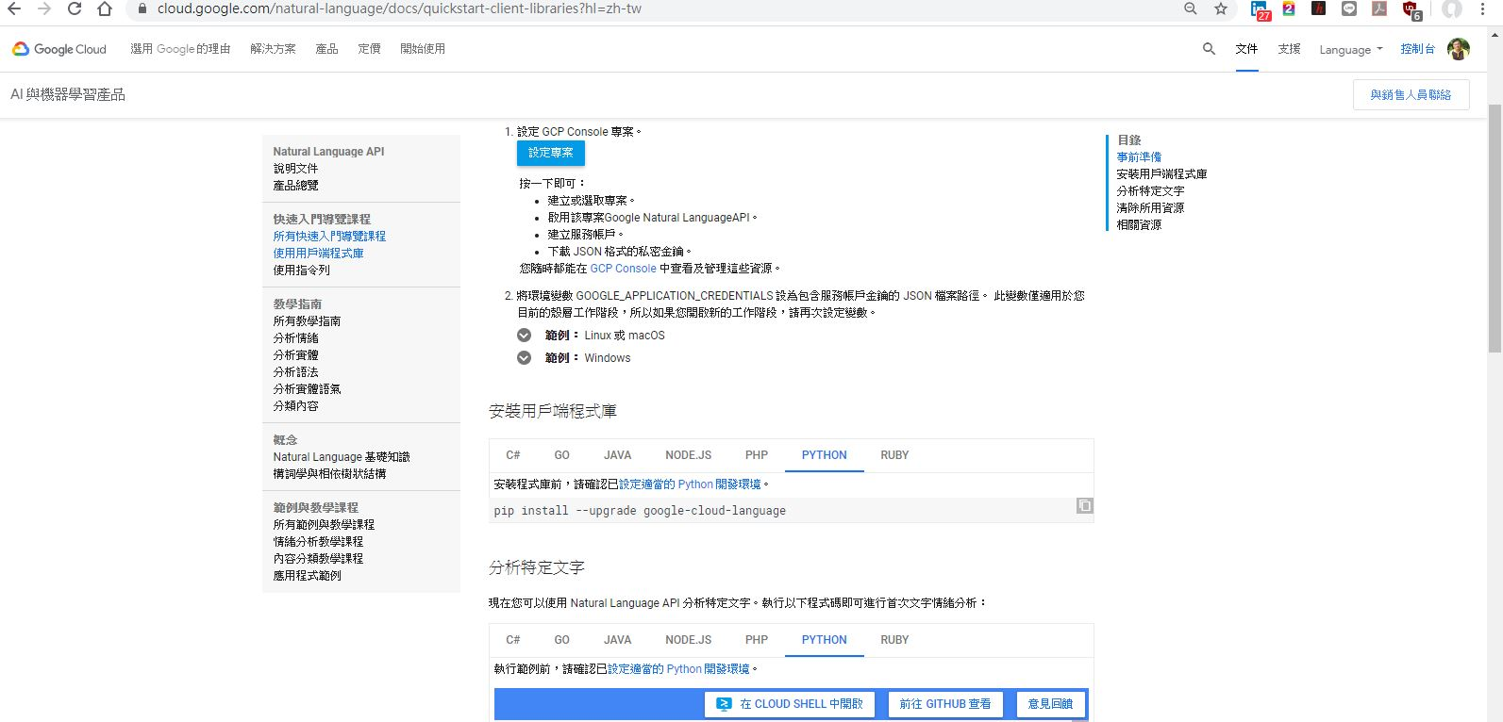
Quick start GCP Quick-Start

Slide 4
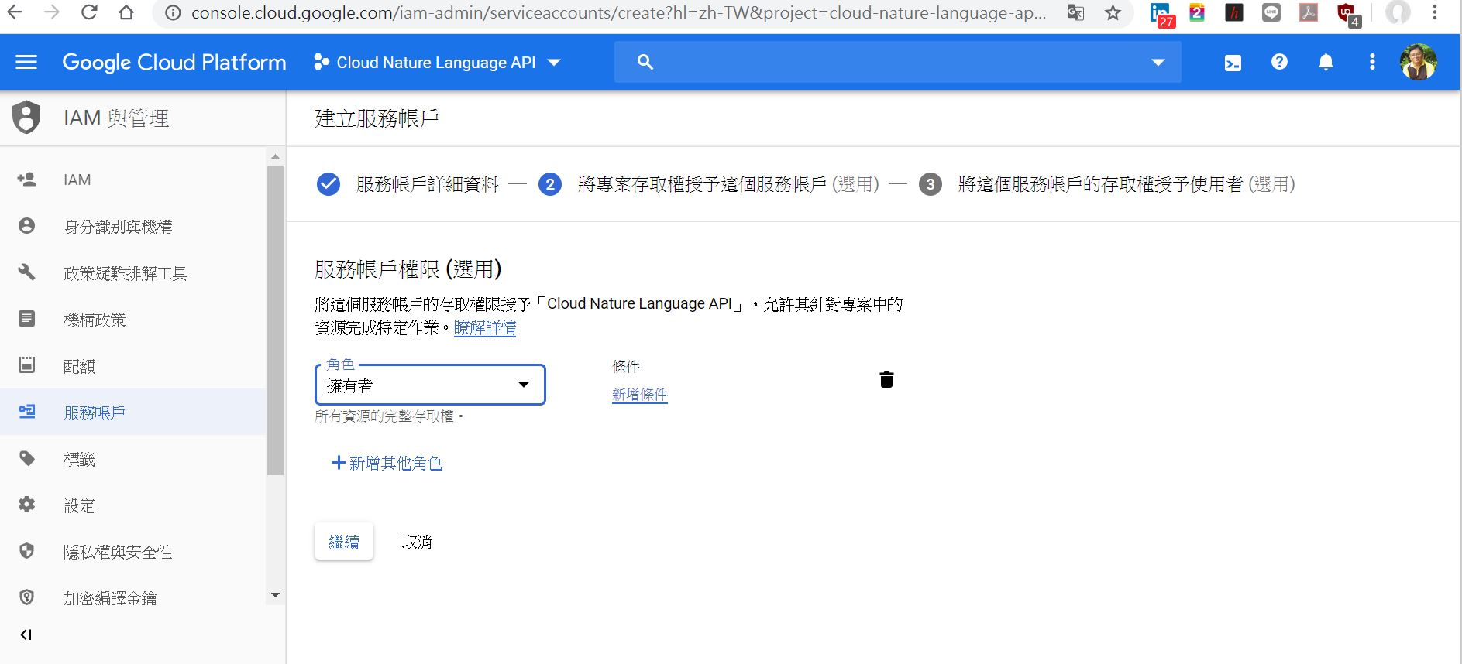
服務帳戶建立

Slide 5
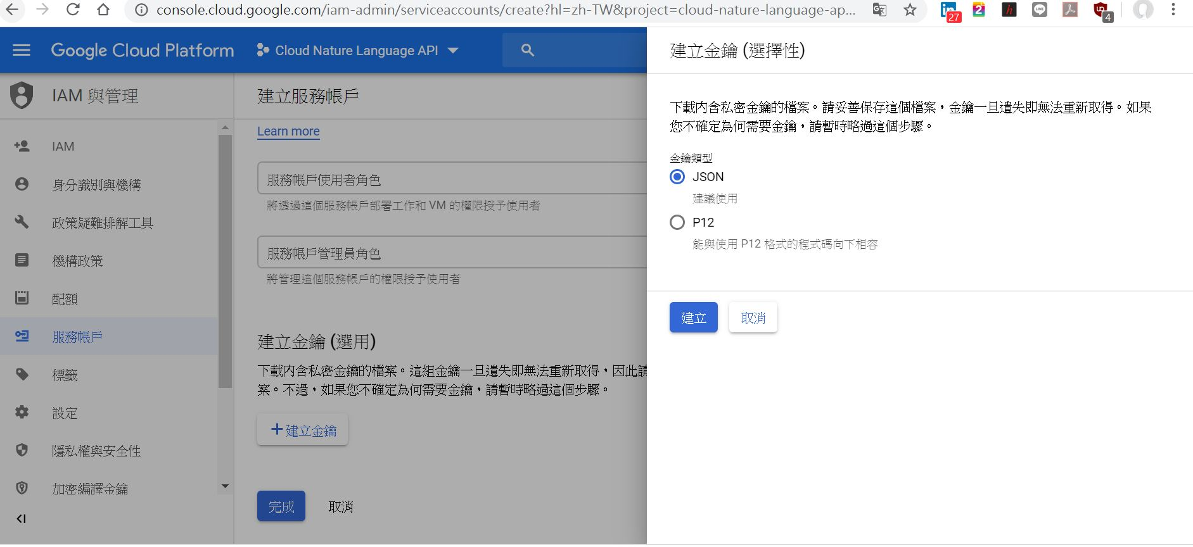
建立金鑰，下載JSON檔

Slide 6
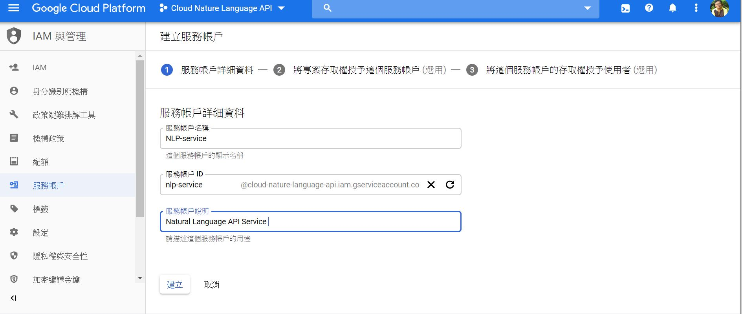

Slide 7
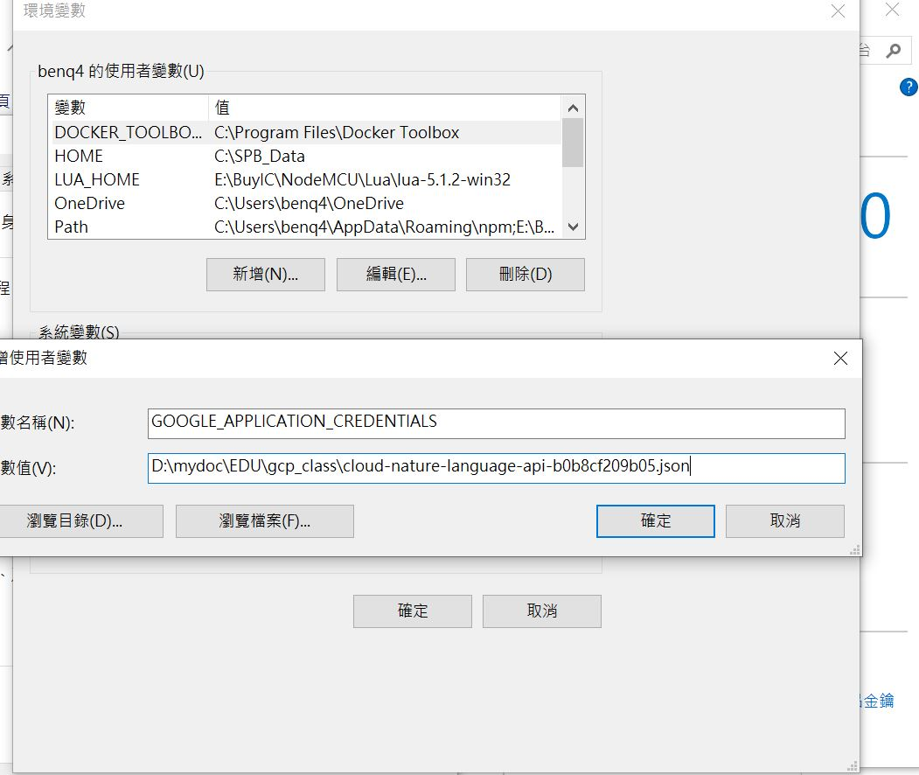
Windows 環境變數加入金鑰路徑 set GOOGLE_APPLICATION_CREDENTIALS=[PATH]

Slide 8
python3 -m pip install iso-639
pip install google-cloud-language
設定python開發環境
安裝用戶端程式庫: pip install --upgrade google-cloud-language
分析特定文字
下載及設定金鑰: IAM與管理➔服務帳戶➔下載金鑰
Windows GCP SDK 安裝設定
=> pip install google-cloud-language

Slide 9
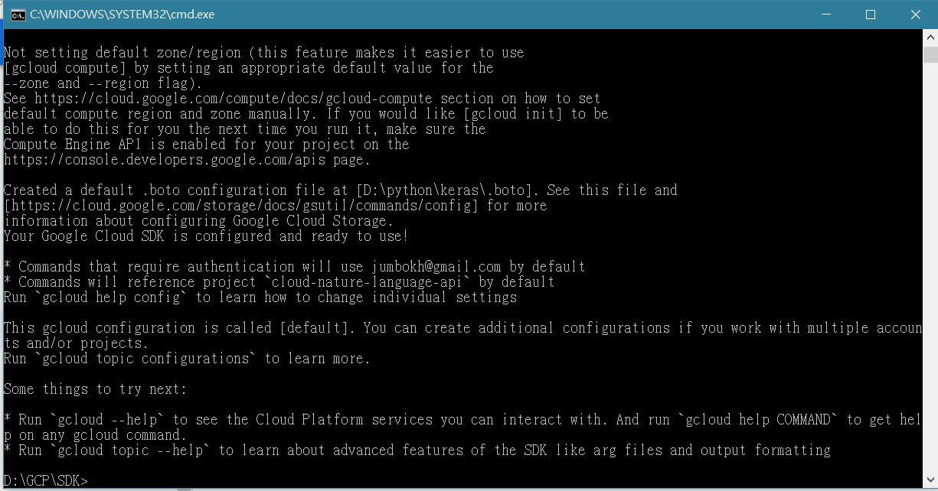
Install GCP sdk

Slide 10
# Imports the Google Cloud client library
from google.cloud import language
from google.cloud.language import enums
from google.cloud.language import types
# Instantiates a client
client = language.LanguageServiceClient()
# The text to analyze
text = u'Hello, world!'
document = types.Document(
content=text,
type=enums.Document.Type.PLAIN_TEXT)
# Detects the sentiment of the text
sentiment = client.analyze_sentiment(document=document).document_sentiment
print('Text: {}'.format(text))
print('Sentiment: {}, {}'.format(sentiment.score, sentiment.magnitude))

Slide 11
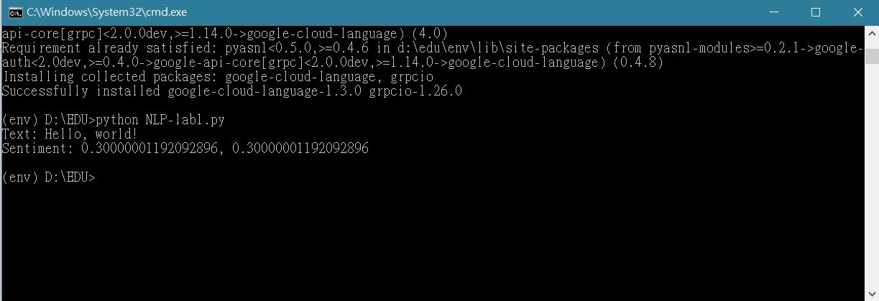
Send message to cloud

Slide 12
情緒分析教學課程

Slide 13
import argparse
from google.cloud import language
from google.cloud.language import enums
from google.cloud.language import types
def print_result(annotations):
score = annotations.document_sentiment.score
magnitude = annotations.document_sentiment.magnitude
for index, sentence in enumerate(annotations.sentences):
sentence_sentiment = sentence.sentiment.score
print('Sentence {} has a sentiment score of {}'.format(
index, sentence_sentiment))
print('Overall Sentiment: score of {} with magnitude of {}'.format(
score, magnitude))
return 0
def analyze(movie_review_filename):
client = language.LanguageServiceClient()

Slide 14
with open(movie_review_filename, 'r') as review_file: # Instantiates a plain text document. content = review_file.read() document = types.Document( content=content, type=enums.Document.Type.PLAIN_TEXT) annotations = client.analyze_sentiment(document=document) # Print the results print_result(annotations) if __name__ == '__main__': parser = argparse.ArgumentParser( description=__doc__, formatter_class=argparse.RawDescriptionHelpFormatter) parser.add_argument( 'movie_review_filename', help='The filename of the movie review you\'d like to analyze.') args = parser.parse_args() analyze(args.movie_review_filename)

Slide 15
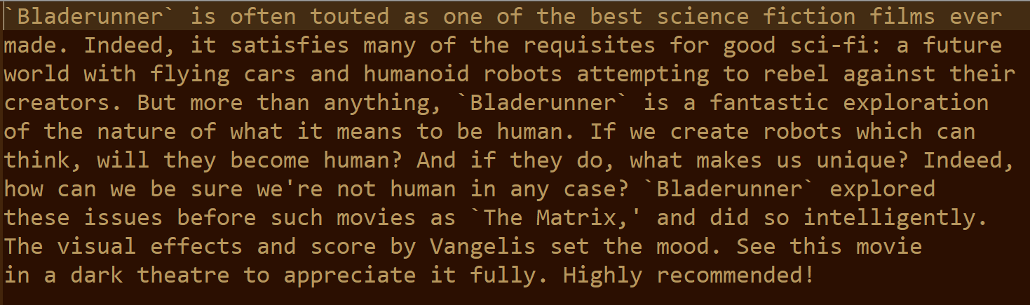
bladerunner-pos.txt

Slide 16
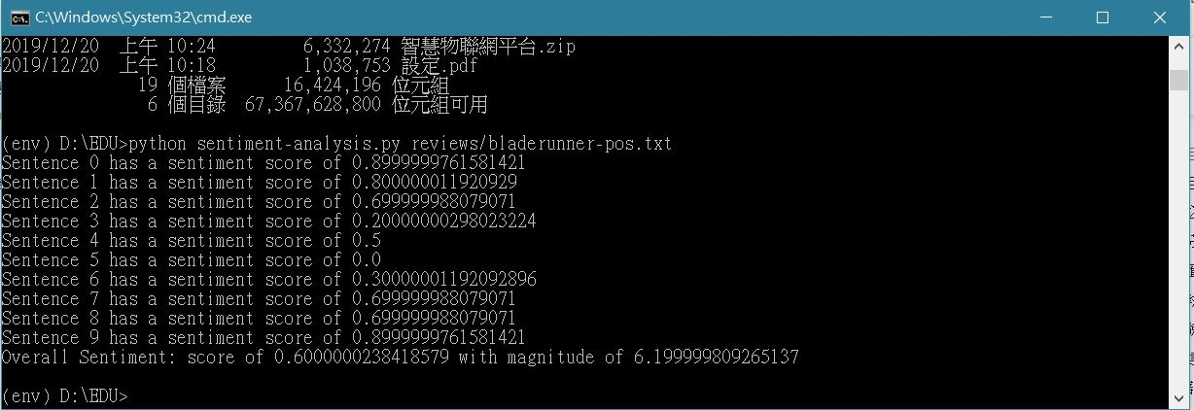
情緒分析教學課程

Slide 17
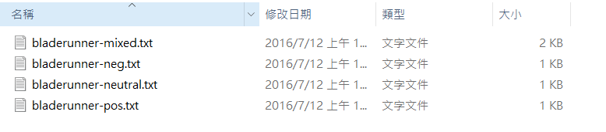
評論範例

Slide 18
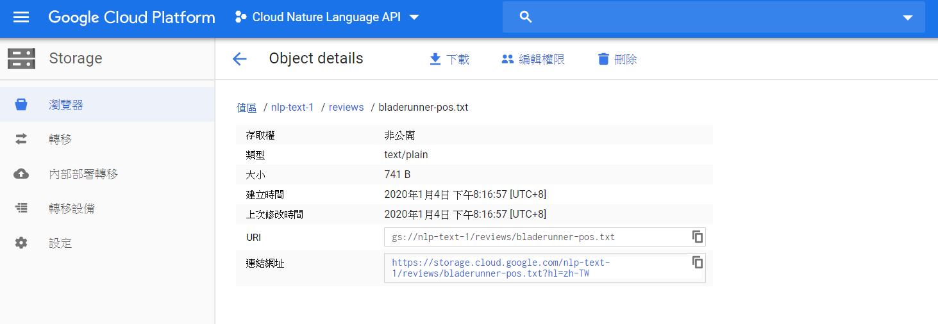
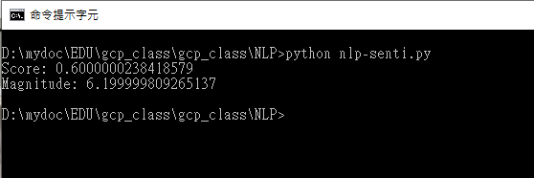

Slide 19
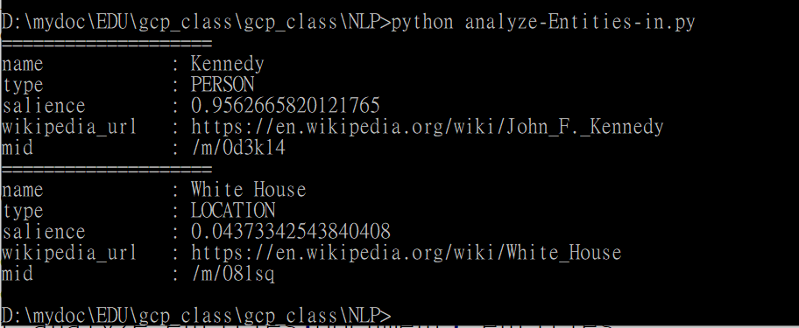
分析實體

Slide 20
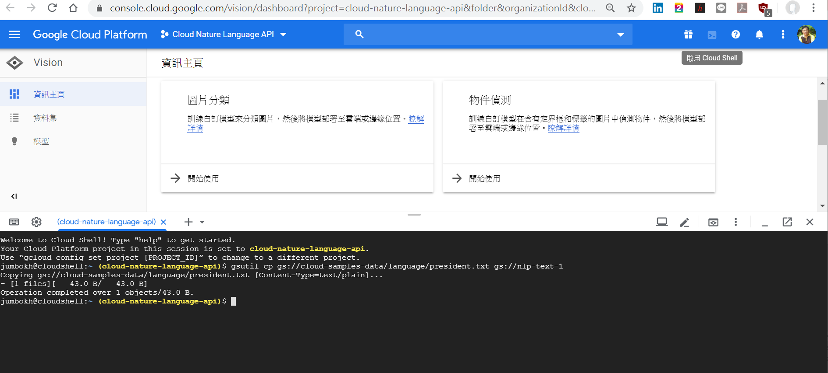
Copy file from another google storage

Slide 21
複製 Google Cloud Plateform 範例至自行新建的 storage
gsutil cp gs://cloud-samples-data/language/president.txt gs://nlp-text-1
範例程式文檔路徑
gs://nlp-text-1/president.txt

Slide 22
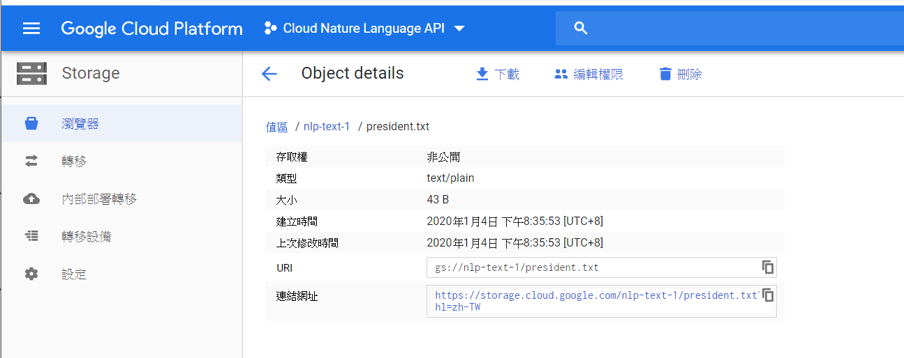
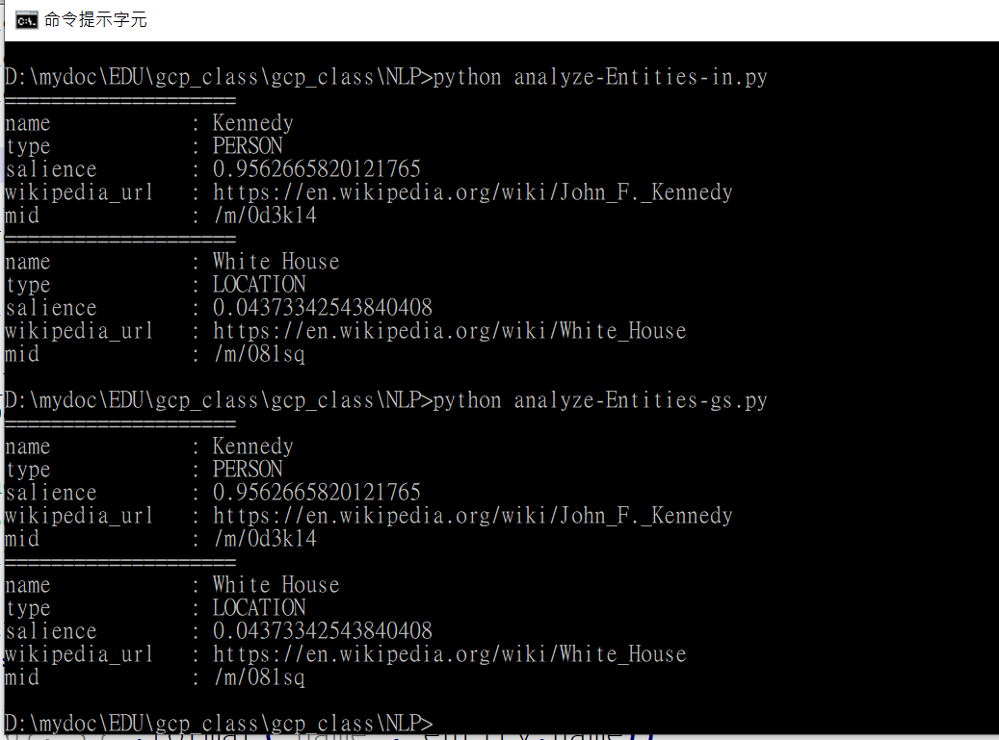

Slide 23
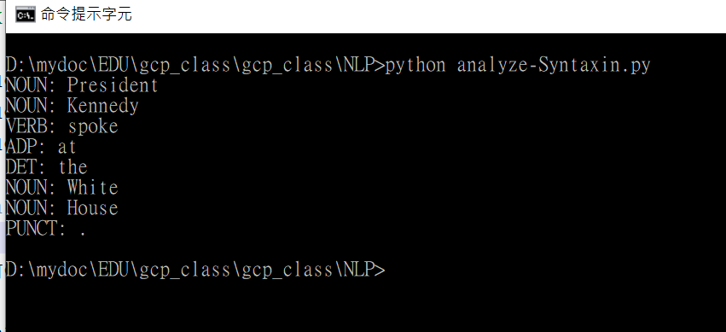
分析語法

Slide 24

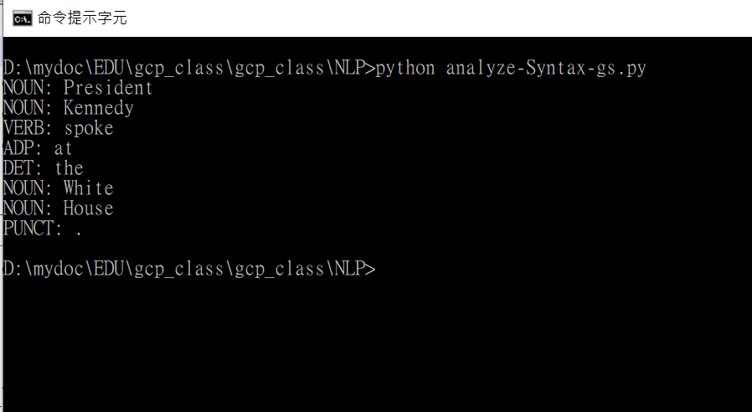

Slide 25
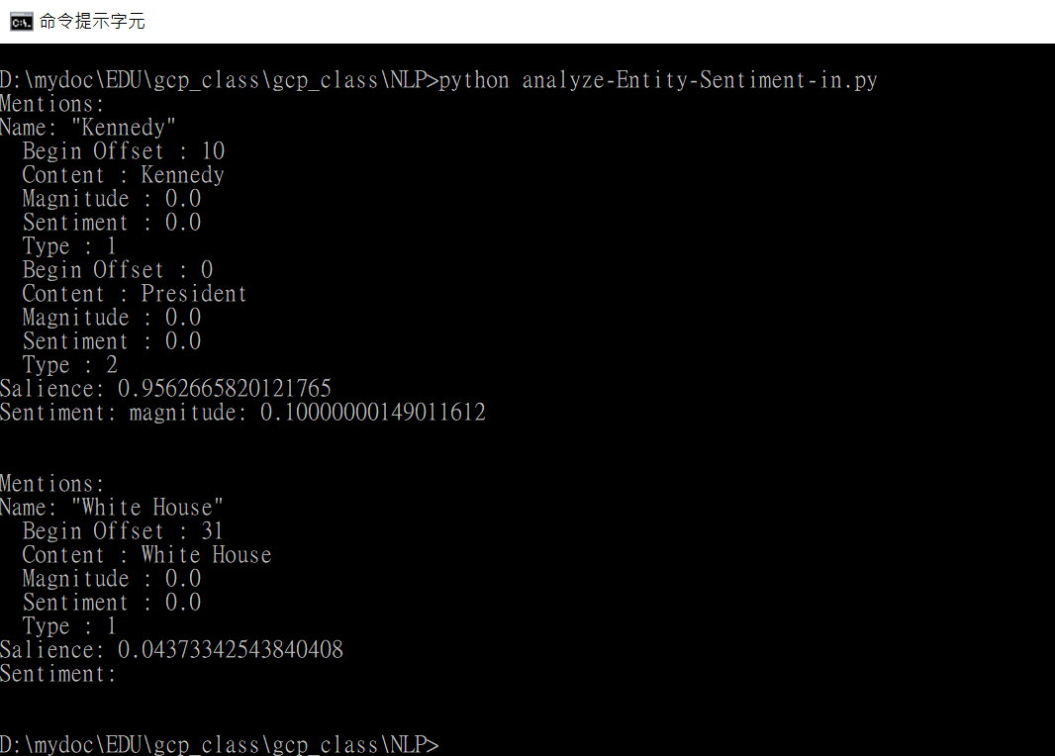
分析實體情緒

Slide 26
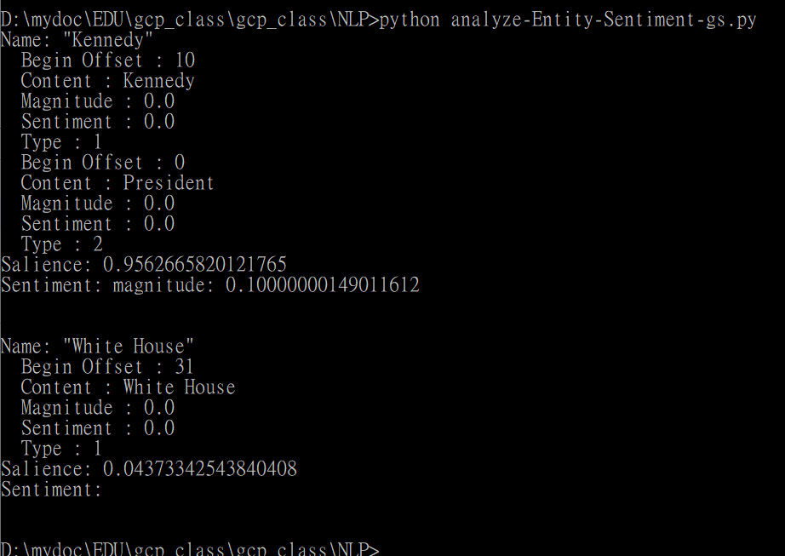
分析實體情緒: data in gs://

Slide 27
內容分類教學

Slide 28
步驟 1：將內容分類
您可以使用 Python 用戶端程式庫建立要求來呼叫 Natural Language API 以分類內容。Python 用戶端程式庫會封裝傳送至 Natural Language API 的要求詳細資料及其回應。
[程式碼]

Slide 29
傳回的結果是使用類別標籤做為索引鍵並以信心分數做為值的字典
{
"/Computers & Electronics": 0.800000011920929,
"/Internet & Telecom/Mobile & Wireless/Mobile Apps & Add-Ons": 0.6499999761581421
}
例如:
python classify_text_tutorial.py classify "Google Home enables users to speak voice commands to interact with services through the Home's intelligent personal assistant called Google Assistant. A large number of services, both in-house and third-party, are integrated, allowing users to listen to music, look at videos or photos, or receive news updates entirely by voice. "

Slide 30
步驟 2：建立多個文字檔案的索引

Slide 31
如要使用教學課程指令碼中的 index 函式， 您需要提供包含多個文字檔案的目錄 (作為輸入內容) 以及儲存索引後輸出內容的檔案路徑 (預設檔案名稱為 index.json)。 index 函式會讀取輸入目錄的各個文字檔案內容， 然後將文字檔案傳遞至 Cloud Natural Language API 以分類為各個內容類別。

Slide 32
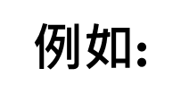
Cloud Natural Language API 針對各個檔案傳回的結果會整理為 單一字典，接著序列化為 JSON 字串並寫入檔案。
{
"android.txt": {
"/Computers & Electronics": 0.800000011920929,
"/Internet & Telecom/Mobile & Wireless/Mobile Apps & Add-Ons": 0.6499999761581421
},
"google.txt": {
"/Internet & Telecom": 0.5799999833106995,
"/Business & Industrial": 0.5400000214576721
}
}
python classify_text_tutorial.py index resources/texts

Slide 33
步驟 3：查詢索引
透過類別標籤查詢
建好索引檔案 (預設檔案名稱 = index.json)，
即可查詢索引來擷取特定檔案名稱及其信心分數。

Slide 34
python classify_text_tutorial.py query-category index.json "/Internet & Telecom/Mobile & Wireless"
輸出:
Query: /Internet & Telecom/Mobile & Wireless
Most similar 3 indexed texts:
Filename: android.txt
Similarity: 0.665573579045
Filename: google.txt
Similarity: 0.517527175966
Filename: gcp.txt
Similarity: 0.5

Slide 35
透過文字查詢 您還可以使用不屬於索引的文字進行查詢。
python classify_text_tutorial.py query index.json "Google Home enables users to speak voice commands to interact with services through the Home's intelligent personal assistant called Google Assistant. A large number of services, both in-house and third-party, are integrated, allowing users to listen to music, look at videos or photos, or receive news updates entirely by voice. "

Slide 36
Query: Google Home enables users to speak voice commands to interact with services through the Home's intelligent personal assistant called Google Assistant. A large number of services, both in-house and third-party, are integrated, allowing users to listen to music, look at videos or photos, or receive news updates entirely by voice. Category: /Internet & Telecom, confidence: 0.509999990463 Category: /Computers & Electronics/Software, confidence: 0.550000011921 Most similar 3 indexed texts: Filename: android.txt Similarity: 0.600579500049 Filename: google.txt Similarity: 0.401314790229 Filename: gcp.txt Similarity: 0.38772339779

Slide 37
相關資源 透過內容分類 API，您可以建立其他應用程式。例如： 將文章的各個段落分類，藉此查看主題之間的轉換。 將具有時間戳記的內容分類並分析各段時間的趨勢主題。 比較內容類別分類以及使用 analyzeSentiment 方法的內容情緒分析。 比較內容類別分類以及文字提及實體的分析。

